Slide 1
Meta
Instagram

Slide 2
Problem Statement
You are hired as a data analyst at Meta and asked to collaborate with Marketing team. Marketing teams wants to leverage Instagram's user data to develop targeted marketing strategies that will increase user engagement, retention, and acquisition. Provide insights and recommendations to address the following objectives

Slide 3
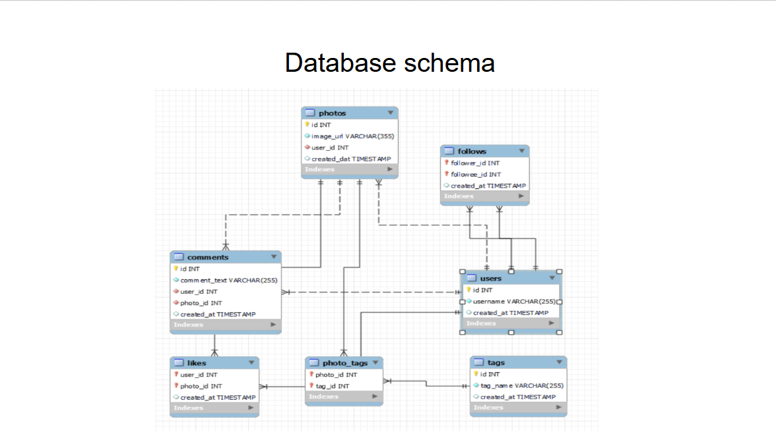
Data Scheme Representation

Slide 4

Introduction
Instagram generates millions of interactions every day through posts, likes, comments, followers, and hashtags. Analysing this data helps understand user behaviour, content performance, and audience engagement.
This project uses SQL to analyse an Instagram Clone database by combining information from multiple relational tables to answer analytical and business-oriented questions.
The insights generated from this analysis can support marketing decisions, influencer identification, personalized recommendations, and long-term platform growth strategies.

Slide 5
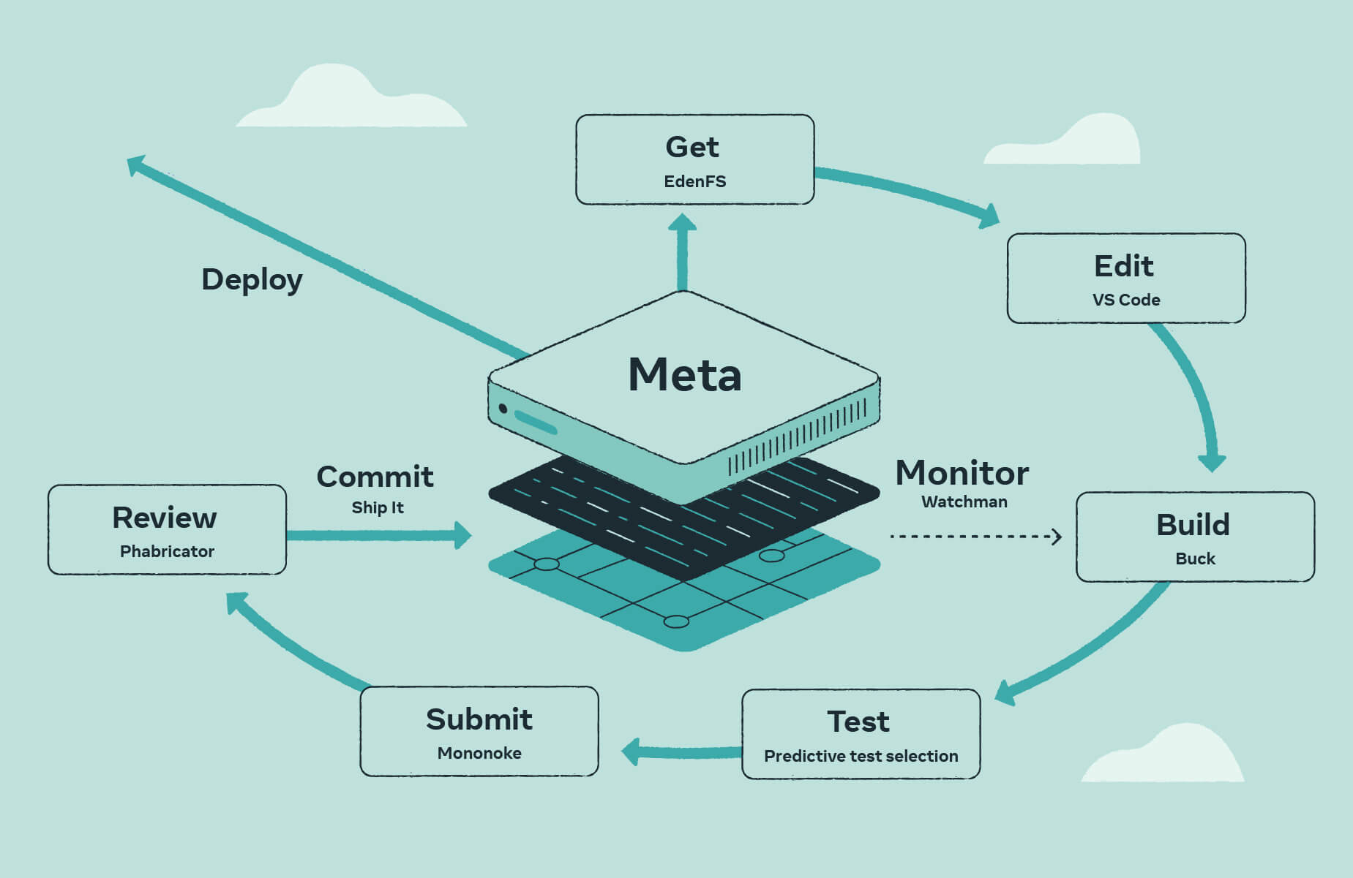
Basic Working of Meta (Instagram)
• Instagram, owned by meta, is a social media platform that allows users to share photos, videos, stories, and reels while interacting through likes, comments, shares, and direct messages.
• The platform connects users through follower–following relationships and uses intelligent recommendation algorithms to display personalized content based on user interests, engagement history, and browsing behaviour.
• Meta analyses user activity and engagement data to improve user experience, enhance content recommendations, deliver targeted advertisements, and help businesses effectively reach their target audience.

Slide 6

Quick View of Dataset
The Instagram Clone database consists of seven interconnected tables that store user accounts, uploaded photos, comments, likes, follower relationships, hashtags, and photo-tag mappings.
Primary Keys and Foreign Keys establish relationships between these tables, allowing SQL joins to retrieve meaningful information across multiple entities.
The relational structure enables comprehensive analysis of user engagement, content popularity, follower networks, and hashtag performance using SQL queries.

Slide 7
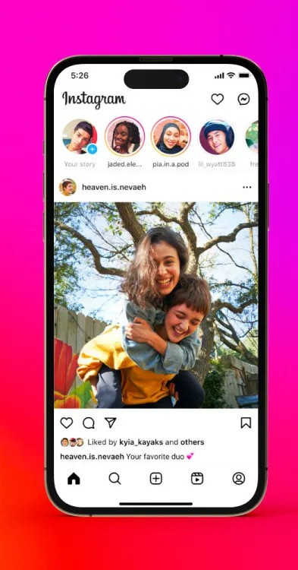
Methodology
• The dataset was imported into MySQL Workbench, where SQL queries were executed to retrieve, combine, and analyse information stored across multiple tables.
• Advanced SQL concepts including Joins, Aggregate Functions, Common Table Expressions (CTEs), Window Functions, CASE statements, and Subqueries were applied to answer business questions.
• The query outputs were exported to Microsoft Excel and converted into visual charts to simplify interpretation and communicate business insights effectively.

Slide 8
Top User Engagement Analysis
This analysis identifies the users receiving the highest number of likes and comments across all their posts. Total engagement provides a reliable measure of audience interaction and content performance.
Users with consistently high engagement are valuable contributors to the platform, as they create content that attracts greater audience participation and interaction.
Businesses can collaborate with these users for influencer marketing, promotional campaigns, and brand partnerships to maximize customer reach and engagement.

Slide 9
Most Popular Hashtags
This analysis identifies the most frequently used hashtags across the platform by counting how many times each hashtag appears in user posts.
Frequently used hashtags represent popular topics and trends, helping businesses understand audience interests and create more relevant content strategies.
Using trending hashtags can significantly improve content visibility, increase audience reach, and enhance the effectiveness of marketing campaigns.

Slide 10
Most Active Users by Number of Posts
This analysis identifies users who contribute the highest number of posts, indicating consistent content creation and platform participation.
Regular content creators help maintain platform activity and generate more opportunities for user interaction and community engagement.
Businesses can collaborate with these users to promote products, launch campaigns, and increase brand visibility through frequent content sharing.

Slide 11
Number of Inactive Users
Users were classified as active if they had performed at least one interaction, such as uploading a photo, liking a post, or posting a comment. Users with no recorded activity were classified as inactive.
The distribution of active and inactive users provides a clear indication of overall platform participation and helps evaluate the effectiveness of user engagement strategies.
Identifying inactive users enables businesses to design personalized re-engagement campaigns, while active users can be retained through rewards, exclusive features, and targeted community initiatives.

Slide 12
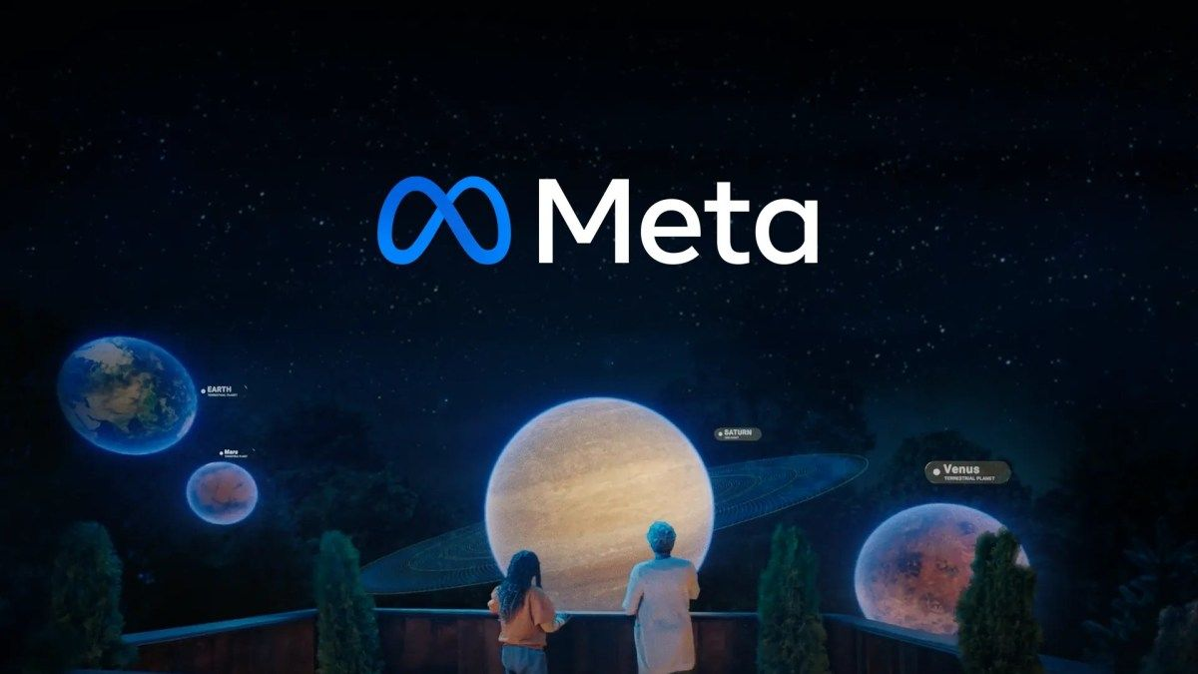
Business Growth & Expansion Strategy
The analysis identified high-performing hashtags and highly engaged users, indicating content categories and communities that attract the greatest audience interaction. These trends can guide future marketing and expansion initiatives.
Businesses can collaborate with influential creators and focus on trending content themes to increase user acquisition, strengthen brand awareness, and improve engagement in both existing and emerging markets.
Although the dataset does not contain geographical information, the engagement patterns provide a foundation for planning targeted marketing campaigns and future platform expansion when combined with regional market data.

Slide 13
Conclusion
The SQL analysis successfully transformed raw Instagram data into meaningful business insights by evaluating user engagement, content performance, hashtag usage, and overall platform activity. These insights demonstrate the value of data-driven decision-making.
The project identified highly engaged users, trending hashtags, and user activity patterns that can support influencer marketing, targeted advertising, user retention strategies, and future business growth initiatives.
Overall, the project highlights how SQL can be effectively used to analyse relational databases, solve real-world business problems, and provide actionable recommendations that improve marketing performance and user engagement.

Slide 14

Recommendations
Collaborate with highly engaged users and potential influencers identified through the analysis to increase brand awareness, improve campaign reach, and encourage greater community participation.
Incorporate high-performing and frequently used hashtags into future marketing campaigns, as they consistently attract higher user engagement and improve content discoverability across the platform.
Develop personalized re-engagement strategies for inactive users through targeted notifications, content recommendations, and promotional campaigns, while rewarding active users with exclusive features or recognition to improve long-term user retention.

Slide 15

References
Meta Platforms, Inc. (2025). About Instagram. https://about.instagram.com/
(Used for the Introduction and Basic Working of Instagram.)
Oracle Corporation. (2025). MySQL 8.0 Reference Manual. https://dev.mysql.com/doc/
(Used for SQL concepts and query development.)
Newton School. (2026). Instagram Clone SQL Database and Project Dataset.
(Primary dataset used for analysis.)
Google Images. (Accessed: June 2026). https://images.google.com/
(Used for Instagram logo, database illustrations, and presentation images.)
Microsoft Support. (2025). Microsoft Excel Documentation. https://support.microsoft.com/excel
(Used for chart creation and visualization.)
W3Schools. (2025). SQL Tutorial and Reference. https://www.w3schools.com/sql/
(Used as a reference for SQL syntax and functions.)

